Slide 1
CPU 相关

Slide 2
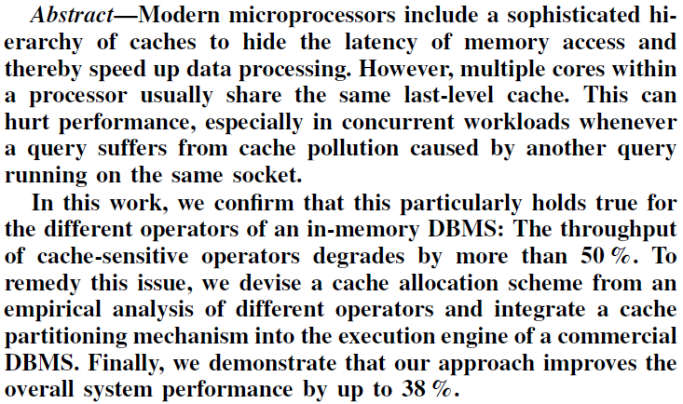
Accelerating Concurrent Workloads with CPU cache partitioning
是个问题，但可能不会太明显，想做一这块的难度会比较大。可以试着分析看看，这种文章有的时候可能是凑结论的

Slide 3
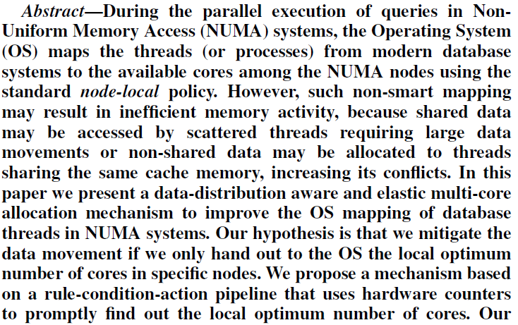
An Elastic Multi-Core Allocation Mechanism for database systems
考虑的比较底层，Cache的使用等

Slide 4

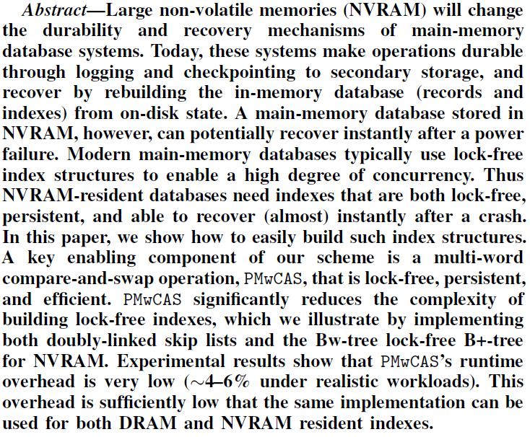
Easy Lock-Free Indexing in Non-Volatile Memory
可以看看，NVM + CPU-friendly 的结构

Slide 5
查询引擎相关

Slide 6
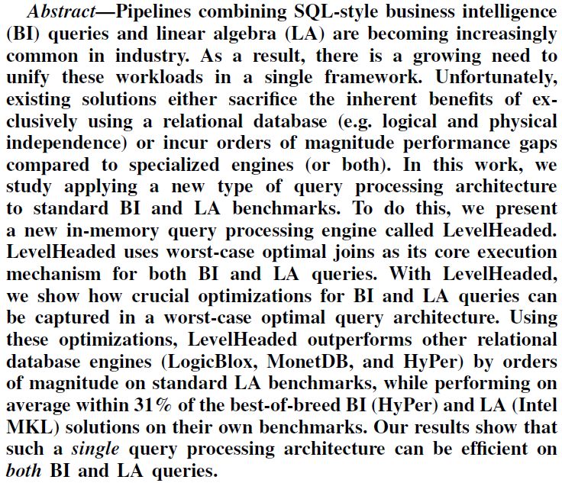
LevelHeaded: A Unified Engine for Business Intelligence and Linear Algebra Querying
力荐，SQL 与 Machine Learning的结合点，大家都可以读一下

Slide 7
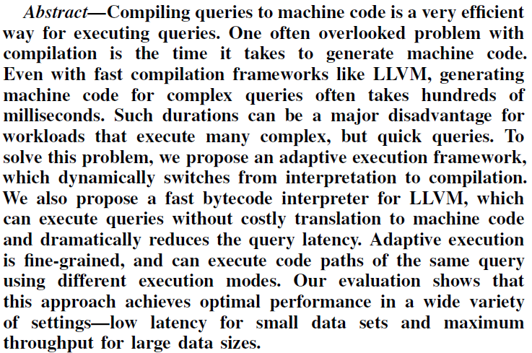
Adaptive Execution of Compiled Queries
值得一读

Slide 8
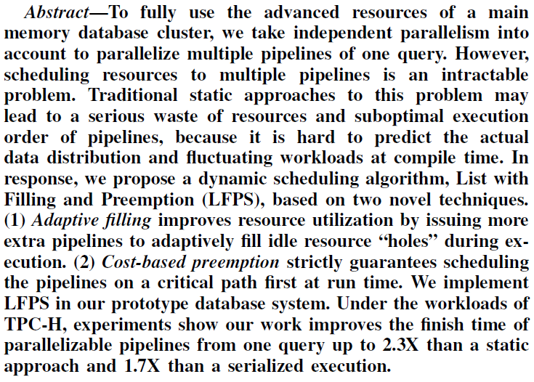
Parallelizing Multiple Pipelines of One Query in a main memory database cluster
并行 + 资源调度 可以读一读

Slide 9
存储相关

Slide 10
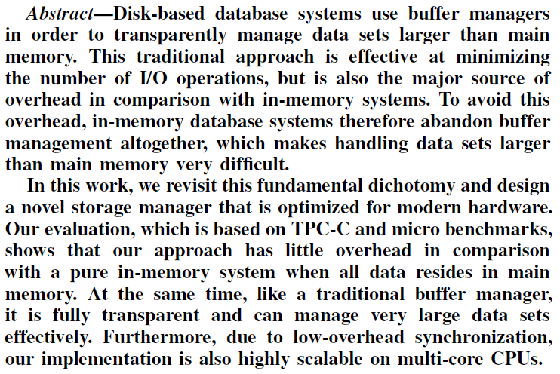
LeanStore: In-Memory Data Management Beyond Main Memory
值得一读，memory overflow的问题

Slide 11
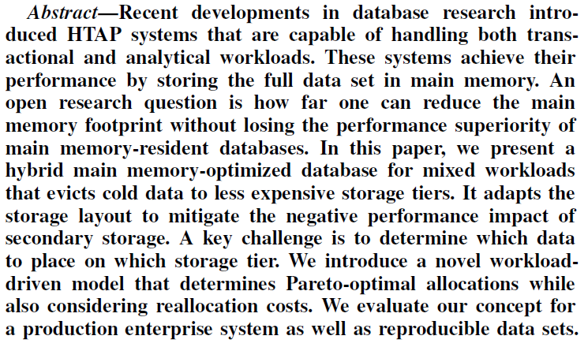
Hybrid Data Layouts for Tiered HTAP Databases with Pareto-Optimal Data Placements
存储层面考虑 HTAP 的问题，是一个好问题。意义不太好说

Slide 12
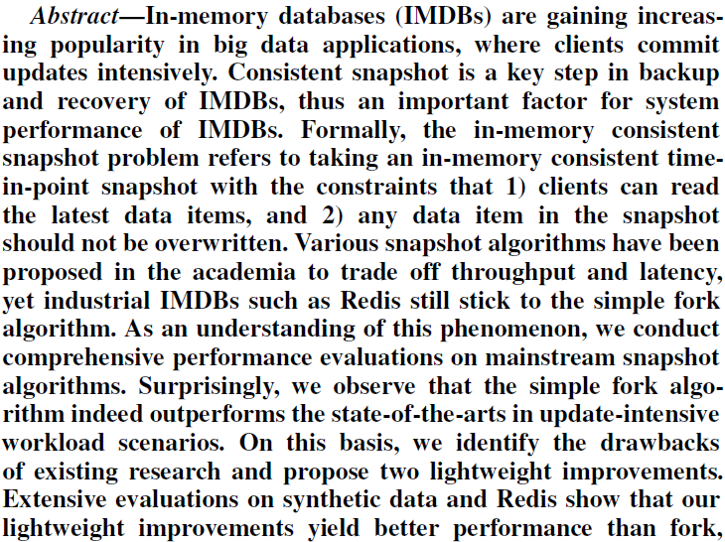
Consistent Snapshot Algorithms for In-Memory Database Systems: Experiments and Analysis
经典数据库问题的深入分析，推荐阅读。

Slide 13

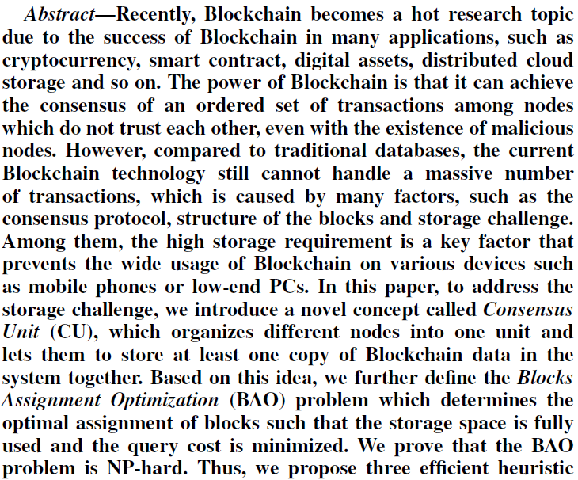
CUB, a Consensus Unit-based Storage Scheme for Blockchain System
蹭热点，做算法，不推荐

Slide 14
并发相关

Slide 15
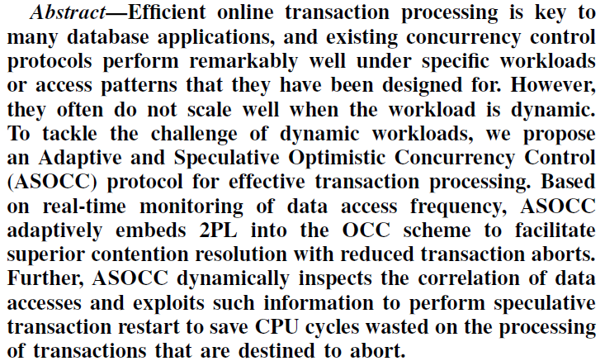
On the Design of Adaptive and Speculative Concurrency Control in Distributed Databases
想做CC的可以看看，总的来说是结合workload来搞一些调度，目前来说也就是这么个思路

Slide 16
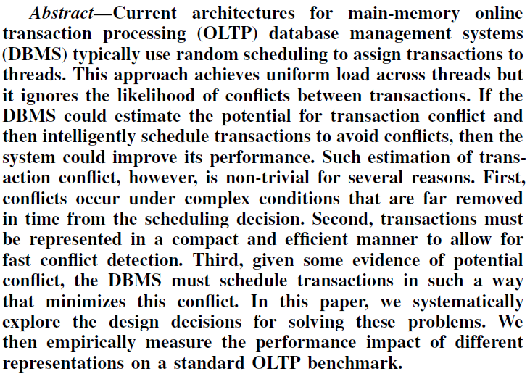
Performance of OLTP via Intelligent Scheduling
队列+调度的方式减少冲突，可以读一读

Slide 17
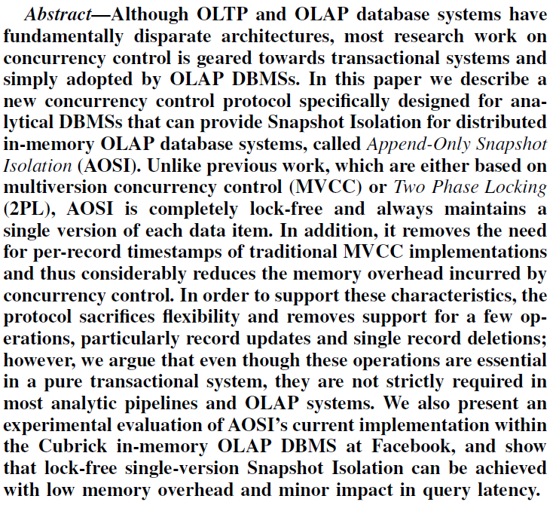
Rethinking Concurrency Control for In-Memory OLAP DBMSs
结合 HTAP 考虑 CC，可以读一读

Slide 18
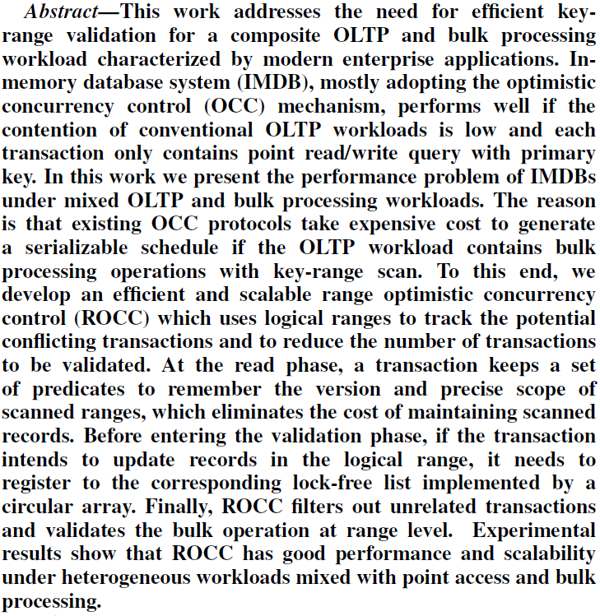
Range Optimistic Concurrency Control for a composite OLTP and Bulk Processing Workload
结合负载，推一套方法

